Slide 1
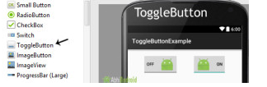
ToggleButton (On/Off)
Is used to display checked and unchecked state of a button.
ToggleButton basically an off/on button with a light indicator which indicate the current state of toggle button.
The most simple example of ToggleButton is doing on/off in sound, Bluetooth, wifi, hotspot etc.
It is a subclass of compoundButton.

Slide 2
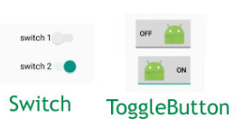
ToggleButton (On/Off)
Since, Android 4.0 version ( API level 14 ) there is an another kind of ToggleButton called Switch which provide the user slider control.
<ToggleButton
android:id="@+id/simpleToggleButton"
android:layout_width="wrap_content"
android:layout_height="wrap_content"/>

Slide 3
ToggleButton (On/Off)
How To Check Current State Of ToggleButton:
To check current state of a toggle button programmatically we use isChecked() method. This method returns a Boolean value either true or false. If a toggle button is checked then it returns true otherwise it returns false. Below is the code which checks the current state of a toggle button.
ToggleButton simpleToggleButton = findViewById(R.id.simpleToggleButton);
Boolean ToggleButtonState = simpleToggleButton.isChecked();

Slide 4
ToggleButton (On/Off)
How To Check Current State Of ToggleButton:
To check current state of a toggle button programmatically we use isChecked() method. This method returns a Boolean value either true or false. If a toggle button is checked then it returns true otherwise it returns false. Below is the code which checks the current state of a toggle button.
ToggleButton simpleToggleButton = (ToggleButton) findViewById(R.id.simpleToggleButton);
Boolean ToggleButtonState = simpleToggleButton.isChecked();

Slide 5
ToggleButton (On/Off)
<ToggleButton
android:id="@+id/simpleToggleButton"
android:layout_width="wrap_content"
android:layout_height="wrap_content"
android:checked="true“ < !-- set the current state of the toggle button-->
android:textOff="Disable"
android:textOn="Enable"
android:textStyle="bold|italic"
android:textSize="25sp"/> <!--text to be displayed whenever toggle button is checked-->
Java Code
simpleToggleButton.setChecked(true);
simpleToggleButton.setTextOn("TextOn Attribute Of Toggle button");
simpleToggleButton.setTextOff("TextOff Attribute Of Toggle button");
simpleToggleButton.setTextColor(Color.RED);

Slide 6
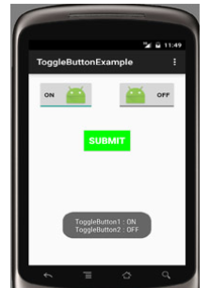
ToggleButton (On/Off)

Slide 7
ToggleButton (On/Off)
public class MainActivity extends AppCompatActivity {
ToggleButton simpleToggleButton1, simpleToggleButton2;
Button submit;
@Override
protected void onCreate(Bundle savedInstanceState) {
super.onCreate(savedInstanceState);
setContentView(R.layout.activity_main);
simpleToggleButton1 = (ToggleButton) findViewById(R.id.simpleToggleButton1);
simpleToggleButton2 = (ToggleButton) findViewById(R.id.simpleToggleButton2);
submit = (Button) findViewById(R.id.submitButton);
submit.setOnClickListener(new View.OnClickListener() {
@Override
public void onClick(View view) {
String status = "ToggleButton1 : " + simpleToggleButton1.getText() + "\n" + "ToggleButton2 : " + simpleToggleButton2.getText();
Toast.makeText(getApplicationContext(), status, Toast.LENGTH_SHORT).show();
}
}); } }

Slide 8
ToggleButton (On/Off)
Example of Linear layout nested with another linear layout. Any layout can be choosen for the Design:
<LinearLayout xmlns:android="http://schemas.android.com/apk/res/android"
xmlns:tools="http://schemas.android.com/tools"
android:layout_width="match_parent"
android:layout_height="match_parent"
android:orientation="vertical"
android:paddingBottom="@dimen/activity_vertical_margin"
android:paddingLeft="@dimen/activity_horizontal_margin"
android:paddingRight="@dimen/activity_horizontal_margin"
android:paddingTop="@dimen/activity_vertical_margin"
tools:context=".MainActivity">
<LinearLayout
android:layout_width="wrap_content"
android:layout_height="wrap_content"
android:layout_gravity="center_horizontal"
android:orientation="horizontal">

Slide 9
ToggleButton (On/Off)
<ToggleButton
android:id="@+id/simpleToggleButton1"
android:layout_width="wrap_content"
android:layout_height="wrap_content"
android:layout_gravity="center_horizontal"
android:checked="false"
android:drawablePadding="20dp"
android:drawableRight="@drawable/ic_launcher"
android:textColor="#000" />
<ToggleButton
android:id="@+id/simpleToggleButton2"
android:layout_width="wrap_content"
android:layout_height="wrap_content"
android:layout_gravity="center_horizontal"
android:layout_marginLeft="50dp"
android:checked="true"
android:drawableLeft="@drawable/ic_launcher"
android:drawablePadding="20dp"
android:textColor="#000" />
</LinearLayout>

Slide 10
ToggleButton (On/Off)
<Button
android:id="@+id/submitButton"
android:layout_width="wrap_content"
android:layout_height="wrap_content"
android:layout_gravity="center"
android:layout_marginTop="50dp"
android:background="#0f0"
android:padding="10dp"
android:text="Submit"
android:textColor="#fff"
android:textSize="20sp"
android:textStyle="bold" />
</LinearLayout>

Slide 11
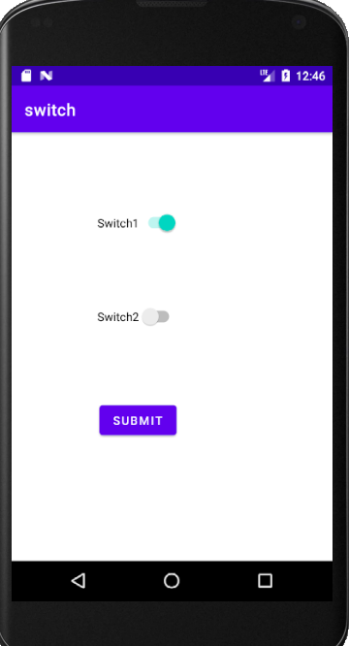

Slide 12
<?xml version="1.0" encoding="utf-8"?>
<androidx.constraintlayout.widget.ConstraintLayout xmlns:android="http://schemas.android.com/apk/res/android"
xmlns:app="http://schemas.android.com/apk/res-auto"
xmlns:tools="http://schemas.android.com/tools"
android:id="@+id/b1"
android:layout_width="match_parent"
android:layout_height="match_parent"
tools:context=".MainActivity">
<Switch
android:id="@+id/s1"
android:layout_width="wrap_content"
android:layout_height="wrap_content"
android:layout_marginTop="84dp"
android:layout_marginEnd="184dp"
android:minHeight="48dp"
android:text="Switch1"
android:textOff="OFF"
android:textOn="ON"
app:layout_constraintEnd_toEndOf="parent"
app:layout_constraintTop_toTopOf="parent" />

Slide 13
<Switch
android:id="@+id/s2"
android:layout_width="wrap_content"
android:layout_height="wrap_content"
android:layout_marginTop="64dp"
android:layout_marginEnd="184dp"
android:checked="true"
android:minHeight="48dp"
android:text="Switch2"
android:textOff="OFF"
android:textOn="ON"
app:layout_constraintEnd_toEndOf="parent"
app:layout_constraintTop_toBottomOf="@+id/s1" />
<Button
android:id="@+id/B1"
android:layout_width="wrap_content"
android:layout_height="wrap_content"
android:layout_marginTop="76dp"
android:layout_marginEnd="186dp"
android:text="Submit"
app:layout_constraintEnd_toEndOf="parent"
app:layout_constraintTop_toBottomOf="@+id/s2" />
</androidx.constraintlayout.widget.ConstraintLayout>

Slide 14
package com.sindhu.aswitch;
import androidx.appcompat.app.AppCompatActivity;
import android.os.Bundle;
import android.view.View;
import android.widget.Button;
import android.widget.Switch;
import android.widget.Toast;
public class MainActivity extends AppCompatActivity {
Switch simpleSwitch1, simpleSwitch2;
Button submit;
@Override
protected void onCreate(Bundle savedInstanceState) {
super.onCreate(savedInstanceState);
setContentView(R.layout.activity_main);
simpleSwitch1 = findViewById(R.id.s1);
simpleSwitch2 = findViewById(R.id.s2);
submit = findViewById(R.id.B1);

Slide 15
submit.setOnClickListener(new View.OnClickListener() {
@Override
public void onClick(View view) {
String statusSwitch1, statusSwitch2;
if (simpleSwitch1.isChecked())
statusSwitch1 = simpleSwitch1.getTextOn().toString();
else
statusSwitch1 = simpleSwitch1.getTextOff().toString();
if (simpleSwitch2.isChecked())
statusSwitch2 = simpleSwitch2.getTextOn().toString();
else
statusSwitch2 = simpleSwitch2.getTextOff().toString();
Toast.makeText(getApplicationContext(), "Switch1 :" + statusSwitch1 + "\n" + "Switch2 :" + statusSwitch2, Toast.LENGTH_LONG).show(); // display the current state for switch's
}
});
}

